Slide 1
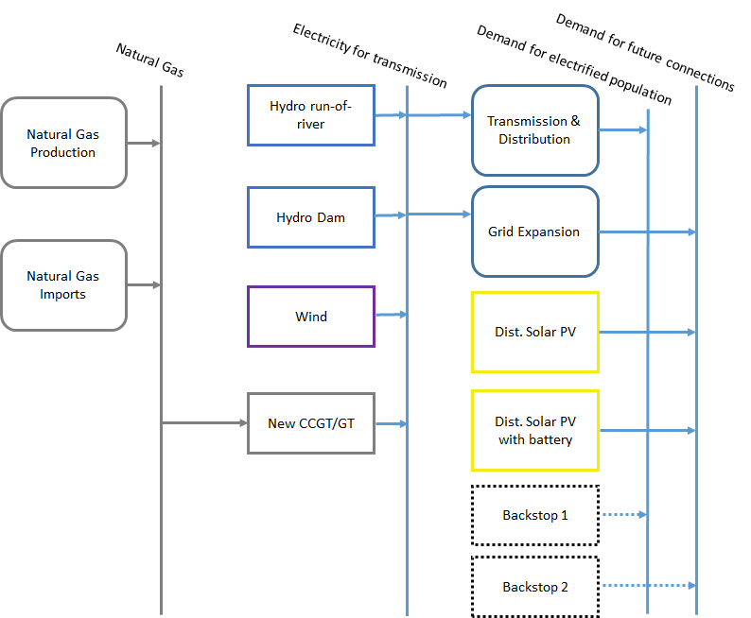
Primary energy supply technologies
Resources
Primary
Secondary
Final

Slide 2
Primary energy supply technologies
Resources
Primary
Secondary
Final

Slide 3
Primary energy supply technologies
Domestic extraction / production of fuels;
Import of fuels;
Fuels can be: coal, oil, oil products, natural gas, LNG, uranium, biomass, etc…

Slide 4
Primary energy supply technologies
They are typically represented in the Reference Energy System by a technology with only outputs (no inputs).
Coal
Coal extraction
Biomass production
Biomass
Natural gas
Natural gas import

